Slide 1
Quant Hack Night
2/16/23

Slide 2
Agenda
Mean Reversion Review
Project - Mean Reversion
Extension: Moving Average Crossovers

Slide 3
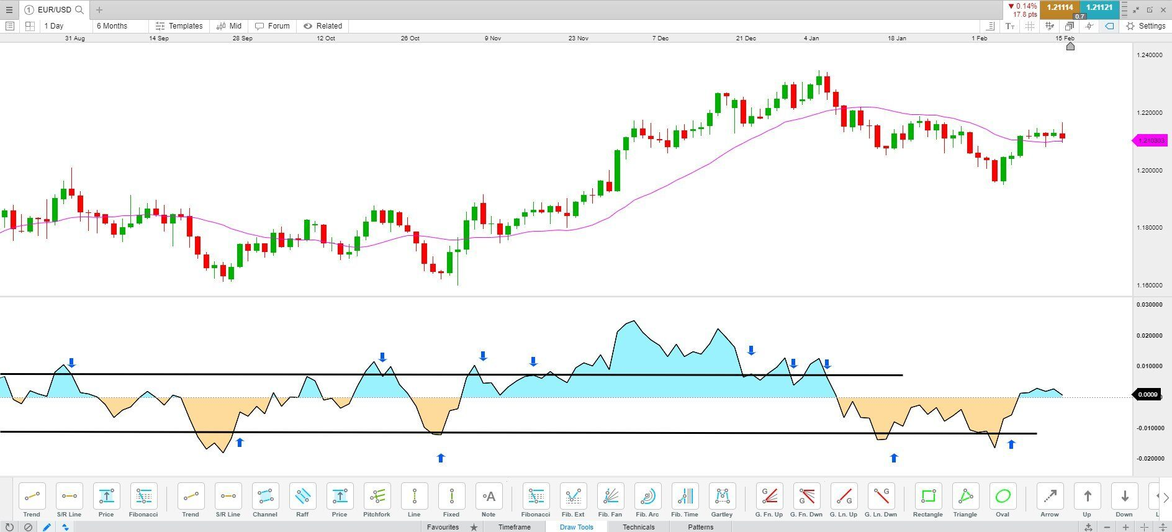
Mean Reversion
Mean reversion, or reversion to the mean, is a theory used in finance that suggests that asset price volatility and historical returns eventually will revert to the long-run mean or average level of the entire dataset.

Slide 4
Moving Average Crossovers
Previously, you all have been looking at a single moving average and using that to determine whether the price is above or below a certain point on the MA line.
How about if we factor in multiple MA lines and use that in our analysis?
We say that when a slower-term moving average crosses above a longer-term moving average, this is a golden cross. When a slower-term moving average crosses below a longer-term moving average, this is a death cross.

Slide 5
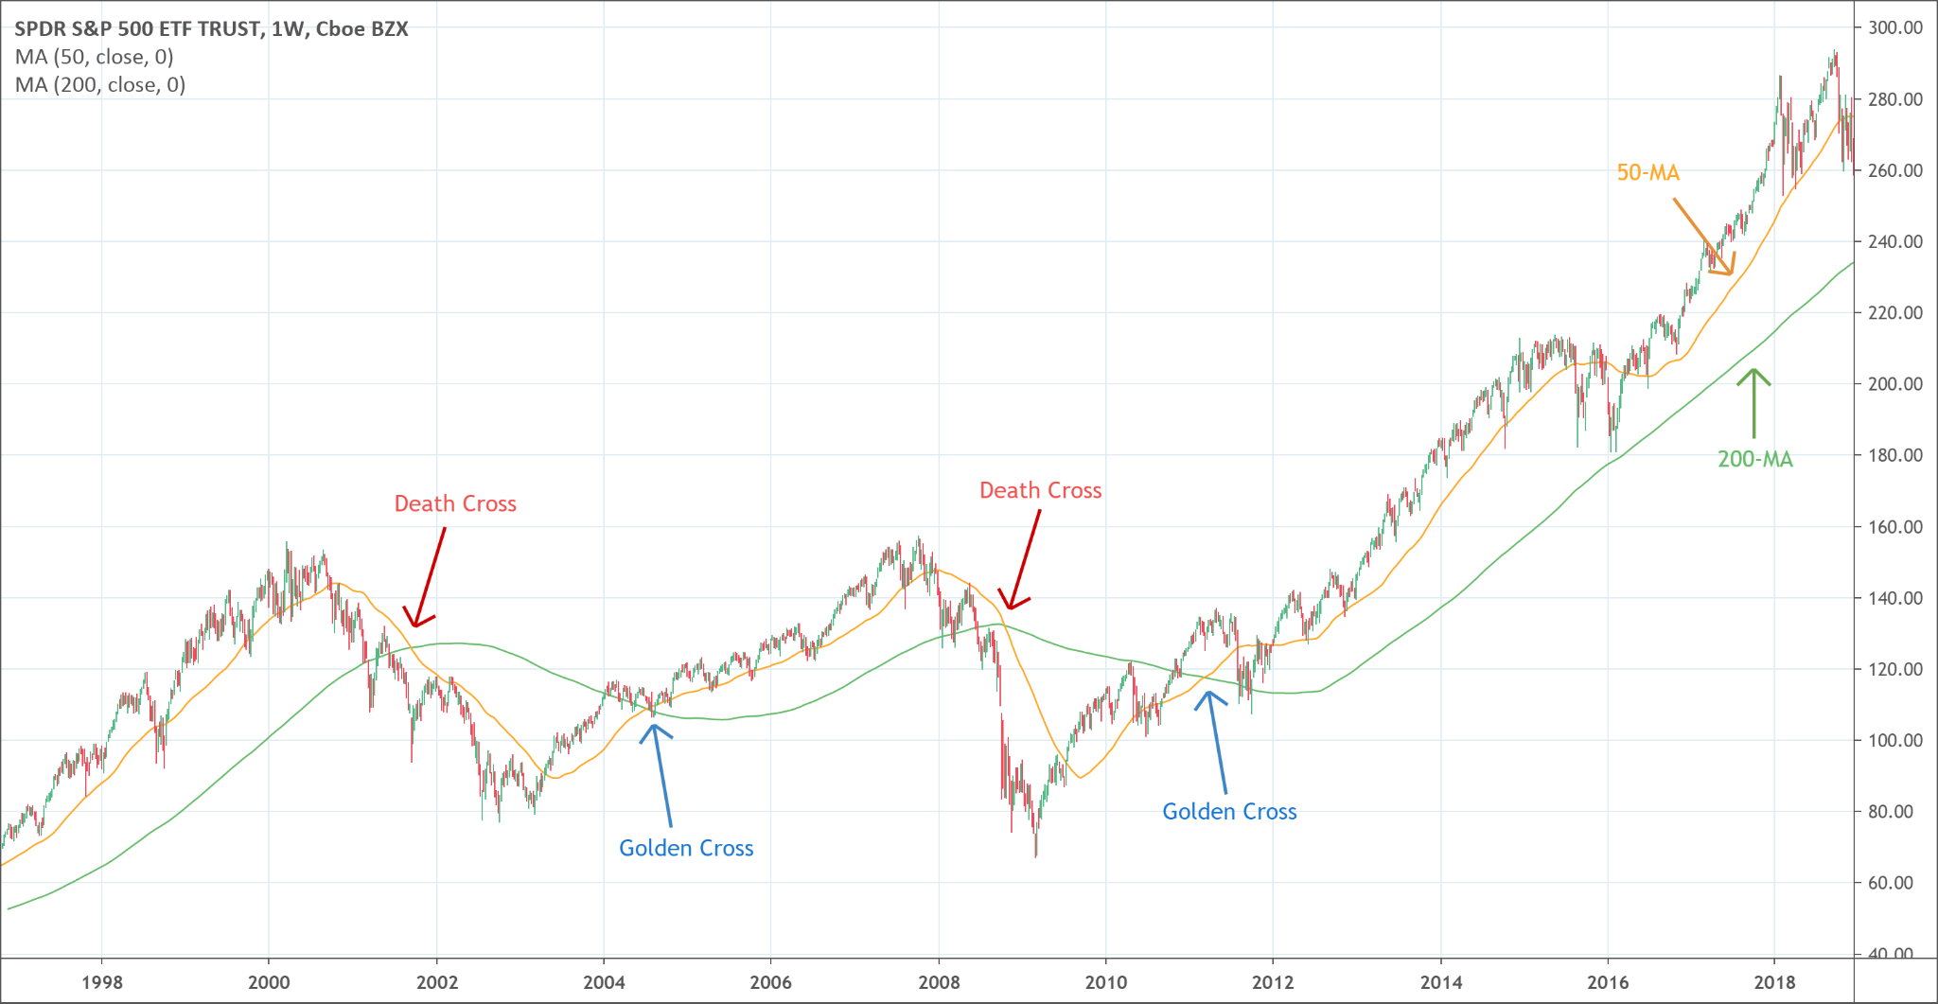
Golden and Death Cross

Slide 6
Project Introduction
Using the sample dataset provided, calculate the 30 day simple moving average for AAPLs stock price.
Graph this as a line graph on top of AAPLs adjusted closing stock price chart to visualize what is happening, and get a list of the historical days in which you could’ve bought the stock (according to the mean reversion algorithm) and a list of the historical days in which you could’ve sold the stock (according to the mean reversion algorithm).
Finally, return a buy day and a sell day out of the days gathered above, that maximize the profit you can make (do later).

Slide 7
Demo Link
Demo Link!
Project 1 link
https://tinyurl.com/quant-p1

Slide 8
Moving Average Types
Simple Moving Average: https://www.investopedia.com/terms/s/sma.asp
Exponential Moving Average: https://www.investopedia.com/terms/e/ema.asp
Weighted Moving Average: https://www.investopedia.com/ask/answers/071414/whats-difference-between-moving-average-and-weighted-moving-average.asp

Slide 9
Mean Reversion - Project Extension
Implement an extension to your mean reversion project which uses information from 2 moving averages as opposed to a single one.
You should make buying and selling decisions based on the golden cross and death cross. Just like before, find a list of all possible buy days according to this algorithm and all possible sell days according to the algorithm.
Once you have potential buy days and potential sell days, find one buy day and one sell day that maximizes your profit.
You have freedom to choose what moving averages you want to use (5, 20, 30, 50, etc) and the type as well (SMA, EMA, WMA)

